Slide 1


Data Cleaning
Notes:
Data cleaning is the process of detecting and correcting or removing corrupt or inaccurate records from a dataset and refers to identifying incomplete or, inaccurate parts of the data and then replacing, modifying, or deleting the them. In this presentation we will focus of methods that used to handle missing data and outliers.

Slide 2
Dimensions of Data Quality
Accuracy: the data was recorded correctly.
Completeness: all relevant data was recorded.
Timeliness: the data is kept up to date.
Consistency: the data agrees with itself.
Uniqueness: entities are recorded once.
Notes:
Let’s start by defining various dimensions of data quality.
Perhaps the most obvious criteria by which to measure data quality is accuracy. For example, does the customer in your customer database actually reside at the associated address? Is the email address actually correct? It’s not hard to imagine a customer record filled with inaccurate data.
The issue of completeness is related to the issue of accuracy. All the information you have may be accurate but you may not have all the information you need. Fore example, if all you have is a customer’s name, obviously that will not be good enough to serve as the foundation for a direct marketing campaign
another significant criteria by which the quality of data can be assessed is the timeliness. For example, do your customer service representatives have the most up-to-date pictures of your customers’ transactions with your organization?
Data can also be measured according to its consistency. For example, are customer accounts activated and deactivated appropriately? It doesn’t make much business sense to send a subscription solicitation to somebody who already subscribes to a magazine.
Finally, data uniqueness requires that data not to be recorded more than once in the dataset.
Duplicated records of costumers may lead to sending them several emails that can be annoying.

Slide 3
Missing Values
Data is not always available
Missing data may be due to
equipment malfunction
inconsistent with other recorded data and thus deleted
data not entered due to misunderstanding
certain data may not be considered important at the time of entry
not register history or changes of the data
Notes:
In data modelling, missing data, or missing values, occur when no data value is stored for the variable in an observation. Missing data are very common and can have a significant effect on the quality of the model. They can occur due to several reasons which some of them are listed here.

Slide 4
Missing Not at Random (MNAR)?
There might be a reason to believe that responders differ from non-responders.
Some examples:
Income - some people may not reveal their salaries
Blood pressure - the blood pressure is measured less frequently for patients with lower blood pressures
MNAR values can contain high predictive power but field expertise is required to detect them.
Notes:
When exploring missing data, it is important to come to a conclusion about the mechanism of missingness or the reason for why data are missing. This can range from arbitrary or random influences to purposeful patterns of nonresponse. Determination of the mechanism is important.
If we can infer the data are missing at random, then the nonresponse is deemed ignorable. However, data missing not at random (MNAR) could potentially be a strong biasing influence. Examples of none random missing data include reported income values. Previous studies show that people are more likely not to report their income if their income is too low or too high.

Slide 5
How to Handle Missing Data?
Ignore the tuple: usually done when class label is missing or small percentage of missing values.
Fill in the missing values manually: tedious + infeasible?
For categorical variables: use a global constant to fill in the missing value: e.g., “unknown”, a new class?!
For numerical variables: use the attribute mean to fill in the missing value.
For numerical or categorical variables : build a model to find the most probable value to fill in the missing value.
Notes:
There are several ways to handle missing data. If the percentage of the missing data is small, one may decide to ignore the missing values. Filling the missing value manually might be an option only if the size of the data is too small. Alternatively, for categorical variables, we can create a new category for the missing values. The mean of the values can used to replaced missing records for numerical variables.
Finally, we can build a model to predict the most likely value to fil in the missing records both for the numerical or categorical variables .

Slide 6
Detecting Missing Values
The function is.na() frame returns TRUE for every element of the input that NA and FALSE otherwise.
The function rowMeans() and colMeans() calculate the average values across rows and columns.
We can use a combination of is.na() and rowMeans() functions to calculate the percentage of missing values per row
We can use a combination of is.na() and colMeans() functions to calculate the percentage of missing values or per column.
Notes:
NA is a logical constant of length 1 which contains a missing value indicator. The generic function is.na in R indicates which elements are missing. Before deciding the strategy to handle the missing values, it might be useful to see the percentage of missing values per column or in various rows. The rowMeans() and colMeans() functions can be used to calculate the average values across rows and columns and we can use them together with the is.na() function to determine the ratio of missing values across columns and rows,

Slide 7
Example
summary(airquality)
## Ozone Solar.R Wind Temp ## Min. : 1.00 Min. : 7.0 Min. : 1.700 Min. :56.00 ## 1st Qu.: 18.00 1st Qu.:115.8 1st Qu.: 7.400 1st Qu.:72.00 ## Median : 31.50 Median :205.0 Median : 9.700 Median :79.00 ## Mean : 42.13 Mean :185.9 Mean : 9.958 Mean :77.88 ## 3rd Qu.: 63.25 3rd Qu.:258.8 3rd Qu.:11.500 3rd Qu.:85.00 ## Max. :168.00 Max. :334.0 Max. :20.700 Max. :97.00 ## NA's :37 NA's :7 ## Month Day ## Min. :5.000 Min. : 1.0 ## 1st Qu.:6.000 1st Qu.: 8.0 ## Median :7.000 Median :16.0 ## Mean :6.993 Mean :15.8 ## 3rd Qu.:8.000 3rd Qu.:23.0 ## Max. :9.000 Max. :31.0 ##
Notes:
So lets have a quick look at an example here. We are using the air quality dataset here, which contains variables such as Ozone, solar R, wind, and temperature, moth and day. Ozone measures the ozone parts in billions, solar measures the radiation, wind is the average speed of wind per hour, and temperature is the maximum daily temperature in degrees in Fahrenheit. So as we can see here, we have 37 records missing for the ozone column, and we have 7 records missing for the Solar R.

Slide 8
Example
colMeans(is.na(airquality))
## Ozone Solar.R Wind Temp Month Day ## 0.24183007 0.04575163 0.00000000 0.00000000 0.00000000 0.00000000
24.1% of values in the Ozone column are missing!
Notes:
If we use colmeans of “is.na(airquality) dataset, we can get the right of the missing values per column. In this case is.na returns back true when a value is missing and call means calculate the average of those values per column. So in this case we can see that for the Ozone, we have 24% of the variables missing, and 4% of the variables are missing for the solar.R and the rest of the variables have no missing variables in them.

Slide 9
Dropping Missing Value
If the number of missing values is small, it may be safe to simply drop rows containing missing values.
complete.cases ( ) returns a logical vector indicating which rows are complete, i.e., have no missing values.
We can use this function to select the complete records (i.e. dropping those with missing values)
Notes:
If the number of missing values in a dataset is small, it might be a good idea to drop them. We can use the complete.cases function from R to identify those records that are not missing. The function returns back a logical vector indicating which rows are complete, meaning that they have no missing values. Identifying those rows and selecting those rows, we can drop the rest of the dataset, which contains missing values.

Slide 10
Example
missing_dropped<-airquality[complete.cases(airquality),] colMeans(is.na(missing_dropped))
## Ozone Solar.R Wind Temp Month Day ## 0 0 0 0 0 0
No missing value!
Notes:
An illustrative example is shown in here. For the air quality dataset, we want to first select the rows that are complete, and then we want to save the results in a new data frame. So in this case, we say airquality, and then we have bracket for the first index, which refers to the rows, we say complete.cases of airquality, which in that case the function returns back the index of the rows that are complete, and then comma, and bracket close. In this case we are expressing that we are interested in all columns of air quality. So we are not dropping any columns at this stage. The result can be saved into a new data frame called “missing_drop.” And then if we examine this new data frame, we can see that the percentage of missing values for all columns is equal to 0, meaning that the dataset doesn’t have any missing values.

Slide 11
Imputing Missing Values
We can also build models to determine the most probable value to fill in the missing value.
This will be the most accurate approach for imputing missing values. However, it may requires more complex computation.
k-Nearest Neighbors (k-NN) is a popular method for imputing missing values.
Notes:
Alternatively, we can build models to predict the values for the missing data. In this case we use other attributes or variables to predict the missing values of a given column. The process needs to be repeated for every column individually. Obviously, this method is the most accurate method for inputting missing values. But as you can see, this is very tedious. The k-Nearest Neighbors, or k-NN for short, is a popular method that is used for inputting missing values.

Slide 12
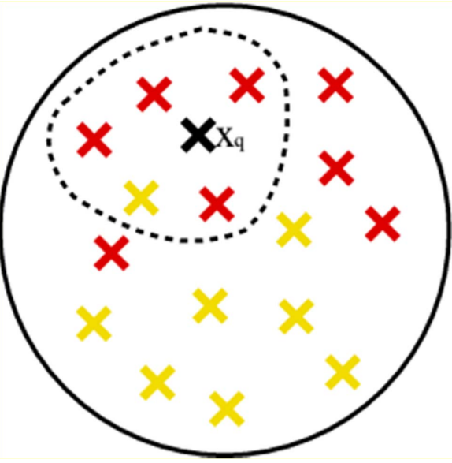
k-Nearest Neighbors
Finding the k neighbors nearest to the missing point and fill in the missing value with the most frequent value or the average value of neighbors.
Finding neighbors in a large dataset may be slow
Defining the right distance metric can be tricky especially when you have a mix of numerical and categorical variables.
Notes:
K-Nearest Neighbors is one of the most basic yet essential classification algorithms in Machine Learning. It belongs to the supervised learning domain and finds intense application in pattern recognition, data mining and intrusion detection. The algorithm tries to measure the distance between the observations and find a cluster of observations that are similar to the record of interest. For imputing the missing values, we ignore the column that contains the missing value and for every record with a missing value we try to find a cluster of records that are similar to the row with the missing value. Subsequently, instead of using the mean value of the overall population, we use the mean of those rows that are most similar to the record with missing values and impute the missing values using the mean value of similar records. However, define a right distance metric, especially when we have both numerical and categorical variables can be tricky. You should also note that this approach can be computationally intensive for large dataset as it requires to calculate the distance between every pair of the records in the dataset and then to sort the values to find the nearest neighbors. The number of neighbors, k, is normally defined between 3 and 10. With too few neighbors, your estimate might be noisy and too many neighbors may also result in including less similar and irrelevant records.

Slide 13
Example: Imputing Missing Values
Library(VIM)
missing_imputed_knn<-kNN(airquality,variable=c("Ozone"),k=4)
colMeans(is.na(missing_imputed_knn))
## Ozone Solar.R Wind Temp Month Day ## 0.00000000 0.04575163 0.00000000 0.00000000 0.00000000 0.00000000 ## Ozone_imp ## 0.00000000
Notes:
Let’s have a look at an example in here. In here we are using the function k-NN, which is located in the library VIM in order to input the missing value for the airquality dataset. So the function is called k-NN, and then we pass the mean of the dataset, which is the airquality. And then we identify which variable we want to imput, which in this case is the Ozone variable. Also, we should specify the number of neighbors K, which in that case is set to 4. The result can be saved to a new data frame, which in this case is “missing_imputed_knn.” Once the imputation is done, we can examine the missing rate for each column using the code names and is.na function, as we have before. In this case, as we can see all the missing values in the Ozone column have been imputed, so we have 0 missing values there. But the missing values in the solar.R column still exist.

Slide 14
Outliers
• Outliers are values thought to be out of range.
“An outlier is an observation that deviates so much from other
observations as to arouse suspicion that it was generated by a
different mechanism”
• Can be detected by standardizing observations and label the
standardized values outside a predetermined bound as outliers
Notes:
An outlier is an observation that lies an abnormal distance from other values in a random sample from a population.
There is, of course, a degree of ambiguity here. Qualifying a data point as an outlier is very context dependent and requires close attention of the modeler and domain experts.
From one and, outliers can mess up the analysis especially when the size of the data is small. But on the other hand, if they represent the actual value of data points, they can be very predictive.
Many statistical tools can mark the observations that far from the rest of the observations. This makes it much easier for the analyst to examine them individually.

Slide 15
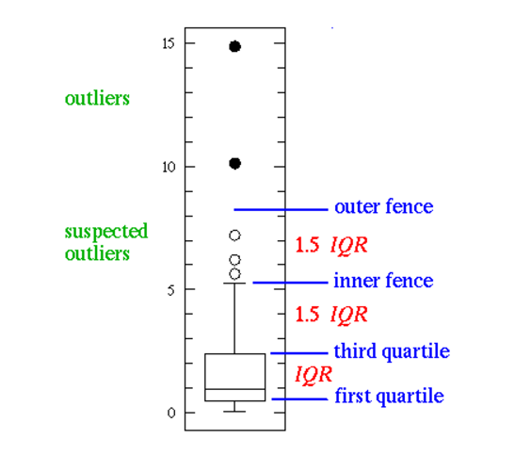
Outliers
• Boxplot:
An observation is an extreme outlier if
(Q1-3IQR, Q3+3IQR), where IQR=Q3-Q1
and declared a mild outlier if it lies
outside of the interval
(Q1-1.5IQR, Q3+1.5 IQR)
Notes:
So here is a visual example of how boxplot tool can be used to mark potential outliers. As you can see, 2 types of outliers have been identified in here, suspected outliers, and actual outliers. Suspected outliers, or soft outliers, are represented as wide circles, whereas the actual hard outliers are represented by black circles. Soft outliers are defined as those where there is one half IQR above the third quartile, whereas the hard outliers are defined as those where there are at least 3 IQR above the third quartile. Similarly, observations that are 1.5 IQR below the first quartile can also be considered as soft outliers. And those observations that are at least 3 IQR below the first quartile can also be seen as hard outliers.

Slide 16
“There are only two things certain in life: death and taxes. ” – Benjamin Franklin “There are only two things certain in data modelling: measurement errors and missing values!” – An Experienced Data Scientist
In predictive analytics, various algorithms are deployed to mine data to find patterns with the goal making predictions.
Predictive analytics systems deploy more complex algorithms and are more computationally intensive
In Predictive Analytics systems the focus is in predicting the future as opposed to describing what has happened in the past which is the focous of BI systems.
Notes:
Pause for 25 seconds

